Slide 1
Slaviša Đurđić
US College Donations
Goal: Analysis of the Tableau “University Advancement, Donations, and Giving” education sample dataset for period 2010-2015.
Instructions:
- Collect data by downloading the Excel file from https://public.tableau.com/app/learn/sample-data?qt-overview_resources=1#qt-overview_resources.
- Use ETL python script to load the data from CSV file to MySQL table.
- Execute some basic SQL queries.
- Build visuals in Tableau (https://public.tableau.com/app/profile/slavisadurdic/viz/USCollegeDonations_16962790623100/USCollegeDonations).
- Run proportion hypothesis testing in Python.
Belgrade, October 2023

Slide 2
MySQL queries
-- No single record returned… which means there are no duplicates
WITH cte AS (
SELECT ï»¿Allocation_Subcategory, City, College, Gift_Allocation, Gift_Amount, Gift_Date, Major, Prospect_ID, State, ROW_NUMBER() OVER(PARTITION BY ï»¿Allocation_Subcategory, City, College, Gift_Allocation, Gift_Amount, Gift_Date, Major, Prospect_ID, State) AS RN
FROM data_analysis.college_donation )
SELECT * FROM cte WHERE RN > 1;

Slide 3
MySQL queries
-- Percentage of Scholarship in total gift amount for all dataset years, and for just year 2015
SELECT
SUM(Gift_Amount) AS gift_amount,
SUM(CASE WHEN Gift_Allocation = 'Scholarship' THEN Gift_Amount END) AS scholarship_gift_amount,
ROUND(SUM(CASE WHEN Gift_Allocation = 'Scholarship' THEN Gift_Amount END)/SUM(Gift_Amount),2) AS scholarship_percentage,
SUM(CASE WHEN Gift_Date LIKE '%2015%' THEN Gift_Amount END) AS gift_amount_y2015,
SUM(CASE WHEN Gift_Date LIKE '%2015%' AND Gift_Allocation = 'Scholarship' THEN Gift_Amount END) AS scholarship_gift_amount_y2015,
ROUND(SUM(CASE WHEN Gift_Date LIKE '%2015%' AND Gift_Allocation = 'Scholarship' THEN Gift_Amount END)/SUM(CASE WHEN Gift_Date LIKE '%2015%' THEN Gift_Amount END),2) AS scholarship_percentage_y2015
FROM data_analysis.college_donation;

Slide 4

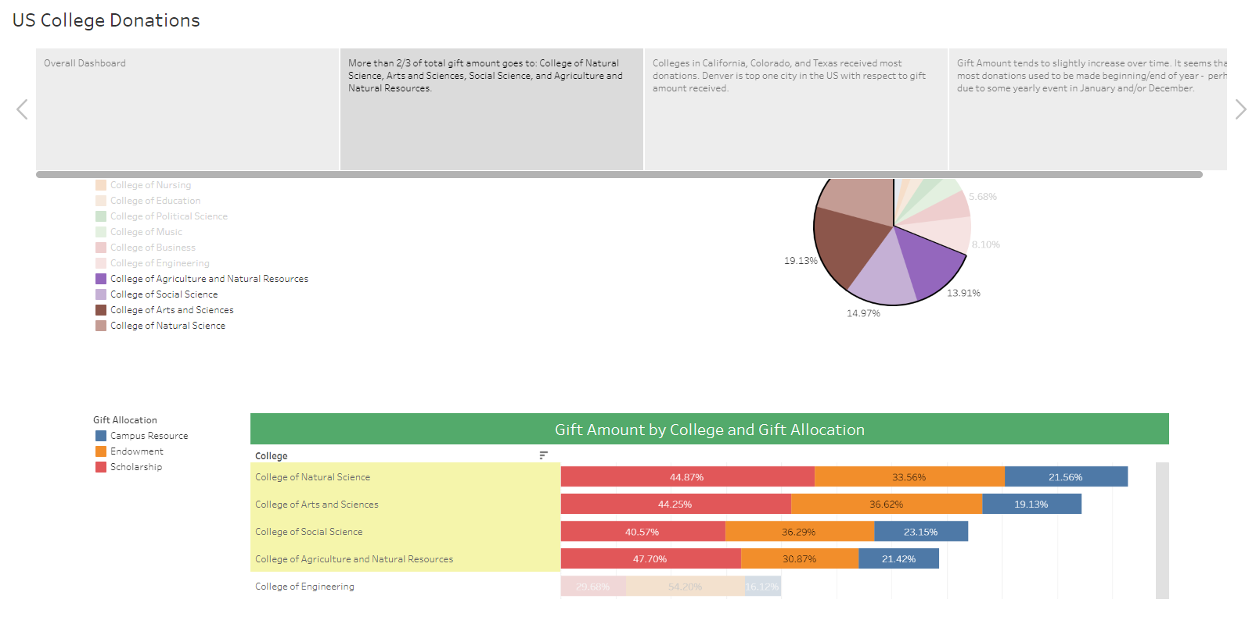

Slide 5
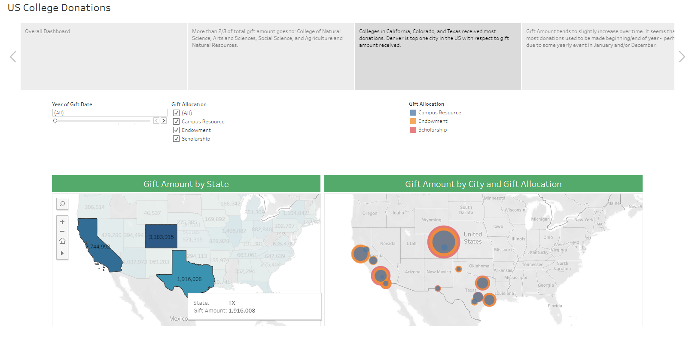

Slide 6
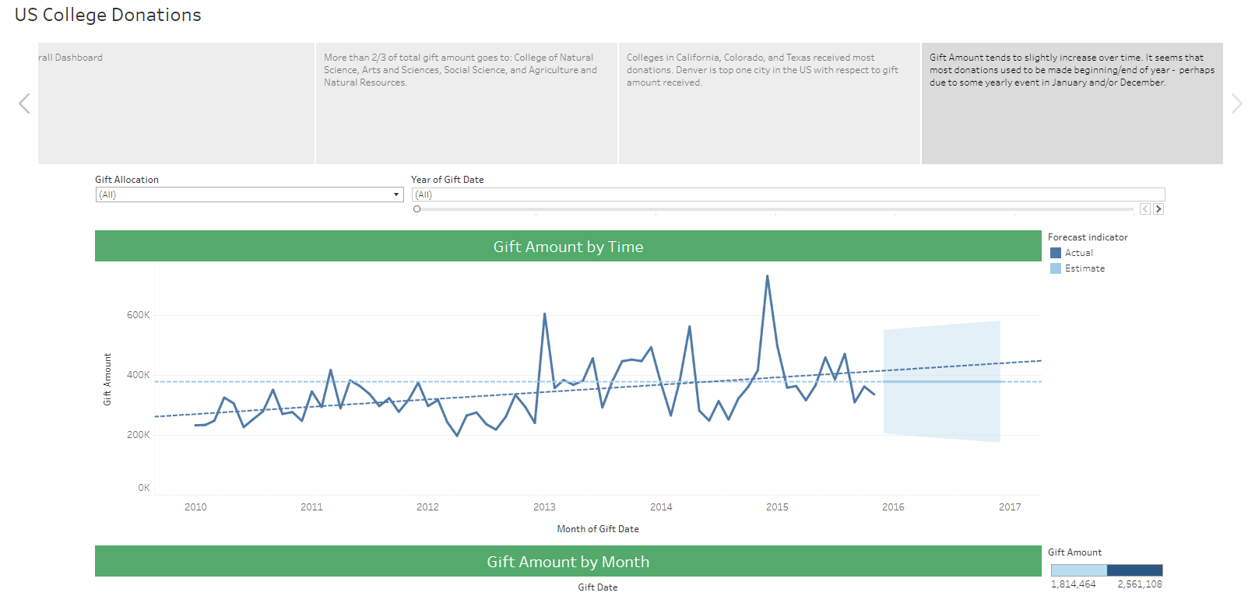

Slide 7
College Donations Project Insights
More than 2/3 of total gift amount goes to: College of Natural Science, Arts and Sciences, Social Science, and Agriculture and Natural Resources.
01
Colleges in California, Colorado, and Texas received most donations. Denver is top one city in the US with respect to gift amount received.
02
Gift Amount tends to slightly increase over time. It seems that most donations used to be made beginning/end of year - perhaps due to some yearly event in January and/or December.
03

